Slide 1

Workplace Violence Prevention Plan Training

Slide 2

Shasta Head Start has developed this Workplace Violence Prevention Plan (WVPP) as part of our health and safety program. Under all circumstances, it is the intent of Shasta Head Start to provide a safe and healthy work environment and to help support employees in the overall identification, correction, and prevention of workplace violence or workplace violence hazards.
This WVPP is in effect as of July 1st, 2024, and is in compliance with Senate Bill 553.
This training will familiarize you with the definitions & requirements of the plan, what to do in the event of a workplace violence incident, and how to identify & correct potential hazards.

Slide 3
The WVPP can be found and obtained through the Standard Operating Procedures Portal (SOP) under section (7.5.1.5).
The responsible people will ensure overall implementation, maintenance, and support of the WVPP.
Responsible People:
Shasta Head Start has designated the HR Manager, Kaylee Cambra, as the WVPP Administrator.
Alternate people with responsibilities include:
Gordon Chatham, Executive Director
Hunter Ashmun, HR Training and Development Coordinator
Supervisors, Directors, Managers, Site Supervisors, Head Teachers

Slide 4
Employee’s Active Involvement
All Shasta Head Start employees share the responsibility for creating and maintaining a safe environment, free from workplace violence. Employees are encouraged to participate in identifying, evaluating, and correcting workplace violence during their monthly site meetings (quarterly for Admin staff). This can include brainstorming sessions, discussions of recent incidents, reviews of safety procedures, and suggestions for procedure changes. Employees are also encouraged to participate in identifying and reporting workplace violence, as well as designing and implementing their ideas for the development and training of the plan through direct contact with their supervisor or the WVPP Administrator. Direct contact can include in person conversation, encrypted email, or phone call/voicemail.

Slide 5
Terms to Understand
“Threat of violence” means any verbal or written statement, including, but not limited to, texts, electronic messages, social media messages, or other online posts, or any behavioral or physical conduct, that conveys an intent, or that is reasonably perceived to convey an intent, to cause physical harm or to place someone in fear of physical harm, and that serves no legitimate purpose
“Workplace violence” includes, but is not limited to, the following:
(i) The threat or use of physical force against an employee that results in, or has a high likelihood of resulting in, injury, psychological trauma, or stress, regardless of whether the employee sustains an injury.
(ii) An incident involving a threat or use of a firearm or other dangerous weapon, including the use of common objects as weapons, regardless of whether the employee sustains an injury.

Slide 6
Workplace violence committed by someone with no legitimate business interests at the worksite and includes violent acts by anyone who enters the workplace or approaches workers with the intent to commit a crime.
Workplace violence directed at employees by customers, clients, patients, students, or visitors.
Workplace violence between two current employees or one current and one former employee.
Workplace violence committed by a non-employee who has a personal relationship with an employee.
Four Types of Workplace Violence

Slide 7
If a Workplace Violence Incident occurs:
Employees will make a report to their supervisor or the WVPP administrator as soon as possible after the incident, preferably in a written format.
The WVPP administrator or the applicable supervisor will immediately undertake an investigation of the incident and complete the Workplace Violence Investigation Form.
Once the investigation is complete, a Violent Incident Log will be completed and submitted to the WVPP Administrator. (no personal identifying information may be included on the log)
Procedures:
If an imminent threat or danger is present, employees should call 911.

Slide 8
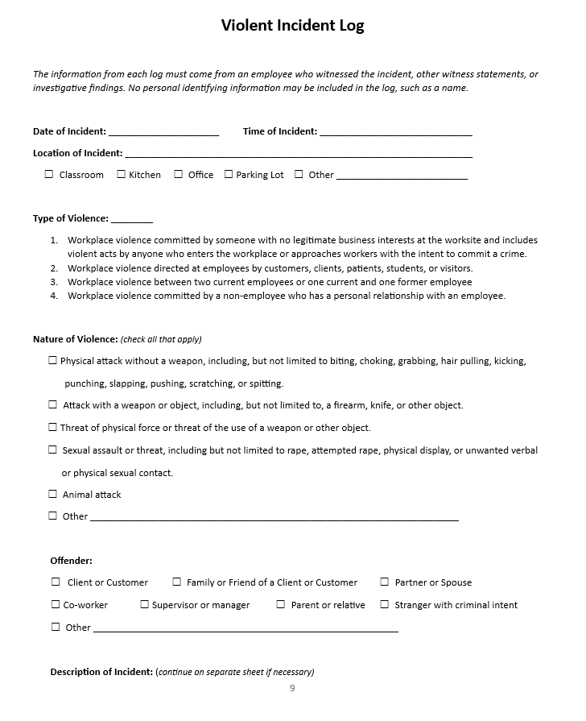
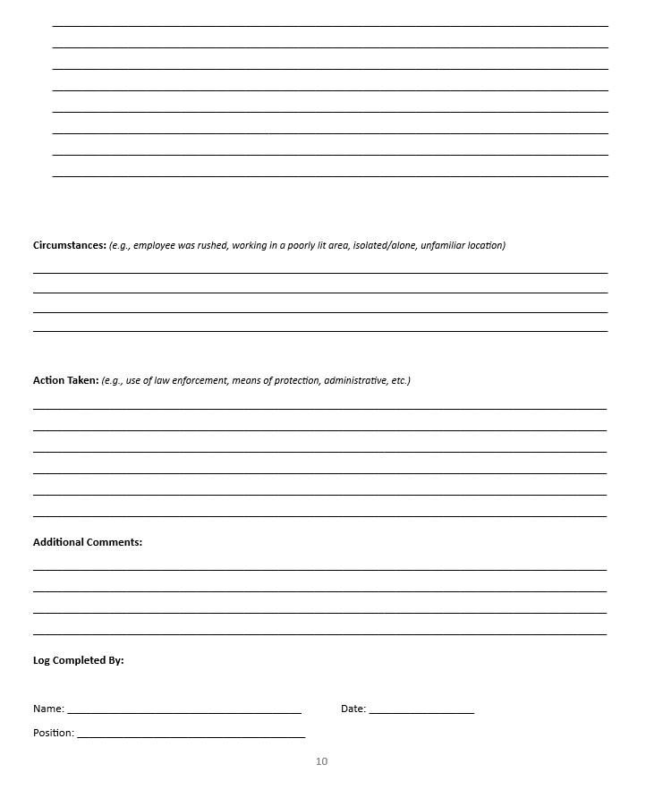
Violent Incident Log
The information in the log must come form an employee who witnessed the incident, witness statements, or investigation findings.
Records of the Violent Incident Log can be obtained by contacting the WVPP administrator.

Slide 9
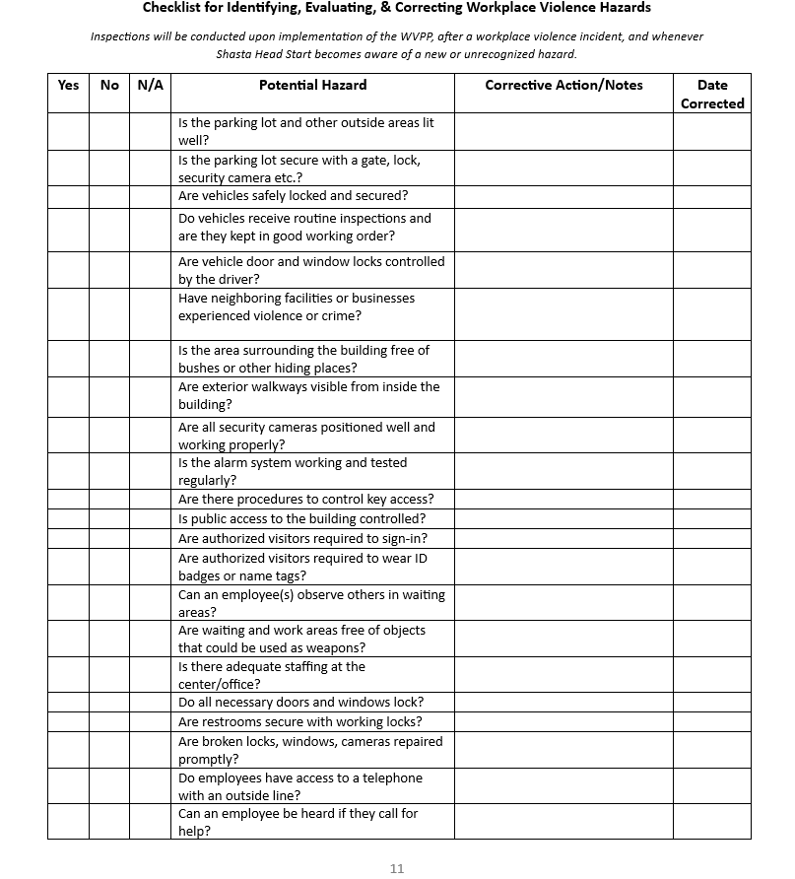
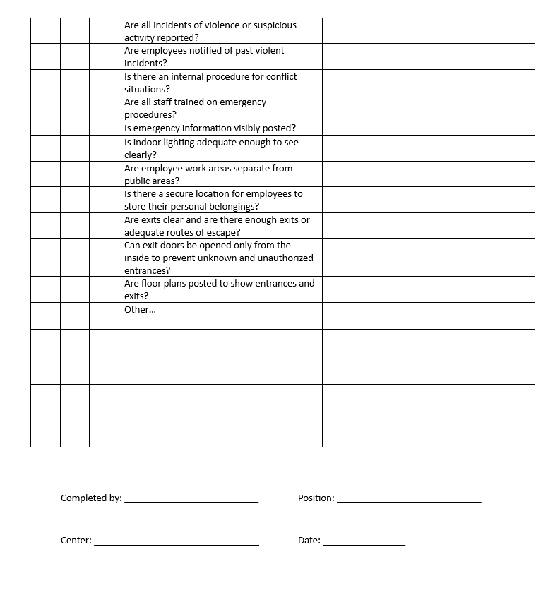
Checklist for Identifying, Evaluating, and Correcting Workplace Violence Hazards
Inspections will be conducted upon implementation of the WVPP, after an incident, and whenever SHS becomes aware of an unrecognized hazard.

Slide 10
In the event of an incident, employees will be notified by their supervisor or the Designated Person in Charge regarding the nature of the incident.
Employees will follow their centers Licensing 610 Form: Emergency Disaster Plan for Child Care Centers. These forms are in prominent locations within each classroom.
In the event of a shelter in place emergency the Designated Person in Charge will initiate the lockdown procedures; locking all of the doors, closing the blinds, and turning the lights off. Under no circumstances should staff be allowed out during the lockdown.
Evacuation and Shelter in Place Procedures

Slide 11


Contact Information
The WVPP Administrator, Kaylee Cambra, can be reached at (530) 245-5117 or EXT 1102 or through email at kcambra@shskids.org.
Use the numbers below if immediate help is needed.
Do not dial 8 to call out before dialing 911.
Emergency Contact | Phone Number
Police Department | 911
Fire Department | 911
Ambulance | 911

Slide 12
Shasta Head Start recognizes that open, two-way communication between our management team and staff about workplace violence issues is essential to a safe and productive workplace.
All employees can report incidents or concerns to Shasta Head Start or law enforcement without fear of reprisal. Any employee who suffers or suspects retaliation should notify the HR Manager.
All questions or concerns can be emailed to hrdept@shskids.org or directed to your supervisor; responses will be as prompt as possible. Thank you for doing your part in keeping Shasta Head Start a safe place to work.

