Slide 1

Classroom Snapshot Guidelines
Linda Brault, Project Director

Slide 2
Telling Your Story
One of the Benchmarks of quality is Monitoring Implementation and Outcomes
A hallmark of strong implementation is data driven decision-making
One measure to use for Classroom Level Implementation is the CA Teaching Pyramid Champion Classroom Snapshot
Currently available
Notes:
We will begin using this tool this year as the next step in our implementation. It will be used by supervisors quarterly.
You will want to bring the tool with you to the TP refresher training to use as a resource.

Slide 3
Teaching Pyramid Observation Tools
TPOT (Teaching Pyramid Observation Tool) was developed for preschool implementation
TPITOS (Teaching Pyramid for Infants and Toddlers Observation Scale) was developed for programs serving children under age 3.
Training is needed to conduct the TPOT or TPITOS with fidelity to the national anchors
Need to visit a classroom for two hours (not including lunch or outside time)
Need 30 or more minutes to interview the lead teacher

Slide 4
Pre- Post- Measures
Some programs have been able to have a pre-TPOT and after the first year of training have a second, and now are planning to have a third measure after a year of implementation following the training
We complete one TPOT on a representative classroom from CA CSEFEL Partner Sites
Training available via Brookes or WestEd (for partner sites only at this time)
Cost and time are often a barrier

Slide 5
But Fidelity is Important!
Benchmark of Quality Critical Element F
All classrooms demonstrate the adoption of the Teaching Pyramid
So how do you know????
We’ve developed a tool to help
Notes:
Why the need for this tool?

Slide 6
Classroom Measure
The Teaching Pyramid Observation Tool (TPOT) is one way to measure implementation
We have been working on a “Champion Snapshot” you can use in classrooms, and we are going to introduce it now!
Notes:
TPOT is the tool to assess Teaching Pyramid. It is long and cumbersome and intense to become certified in the use.
Here is a snapshot of the tool on the right.
YEAH this is exciting, this tool only takes 20 minutes!
Let’s learn more about the tool.

Slide 7
Addresses BOQ Items
Teaching Pyramid Champion Classroom Snapshot
This is a Data Collection Tool for
Critical Element F: All Classrooms demonstrate Adoption
Critical Element J: Monitoring Implementation and Outcomes
Notes:
Review Slide – Leadership team may be familiar with the BOQ and is in TP binders

Slide 8
Instructions
Teaching Pyramid Champion Classroom Snapshot
Enter the classroom at any point in the day
Observe for exactly 20 minutes
Score each item as
  Present by marking “yes” or
  Absent by marking “no”
  as you observe each item or at the end of the observation
Notes:
Review slide
Avoid marking NO until the end of the 20 minutes for most items, you want to give the opportunity for the item to be marked yes until the last minute.

Slide 9
First Impressions
There is an atmosphere of quiet energy, calm, and concentration.
Children are deeply engaged in learning activities, pretend play, and conversation
Adults are deeply engaged in interactions with children (at their eye level, using calm quiet voices) and/or are observing their activities closely
Notes:
Here are the first three items on the tool. Review and elaborate
Adults are not standing waiting for something to happen – engaged as well.

Slide 10
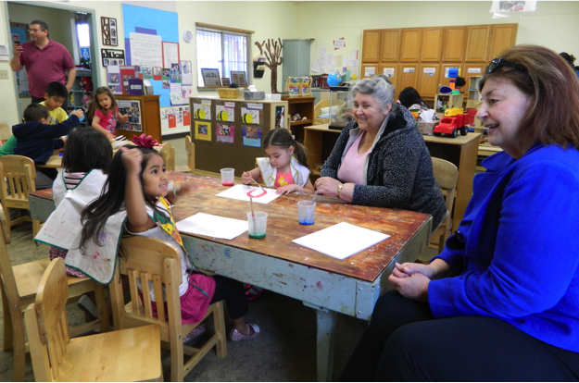
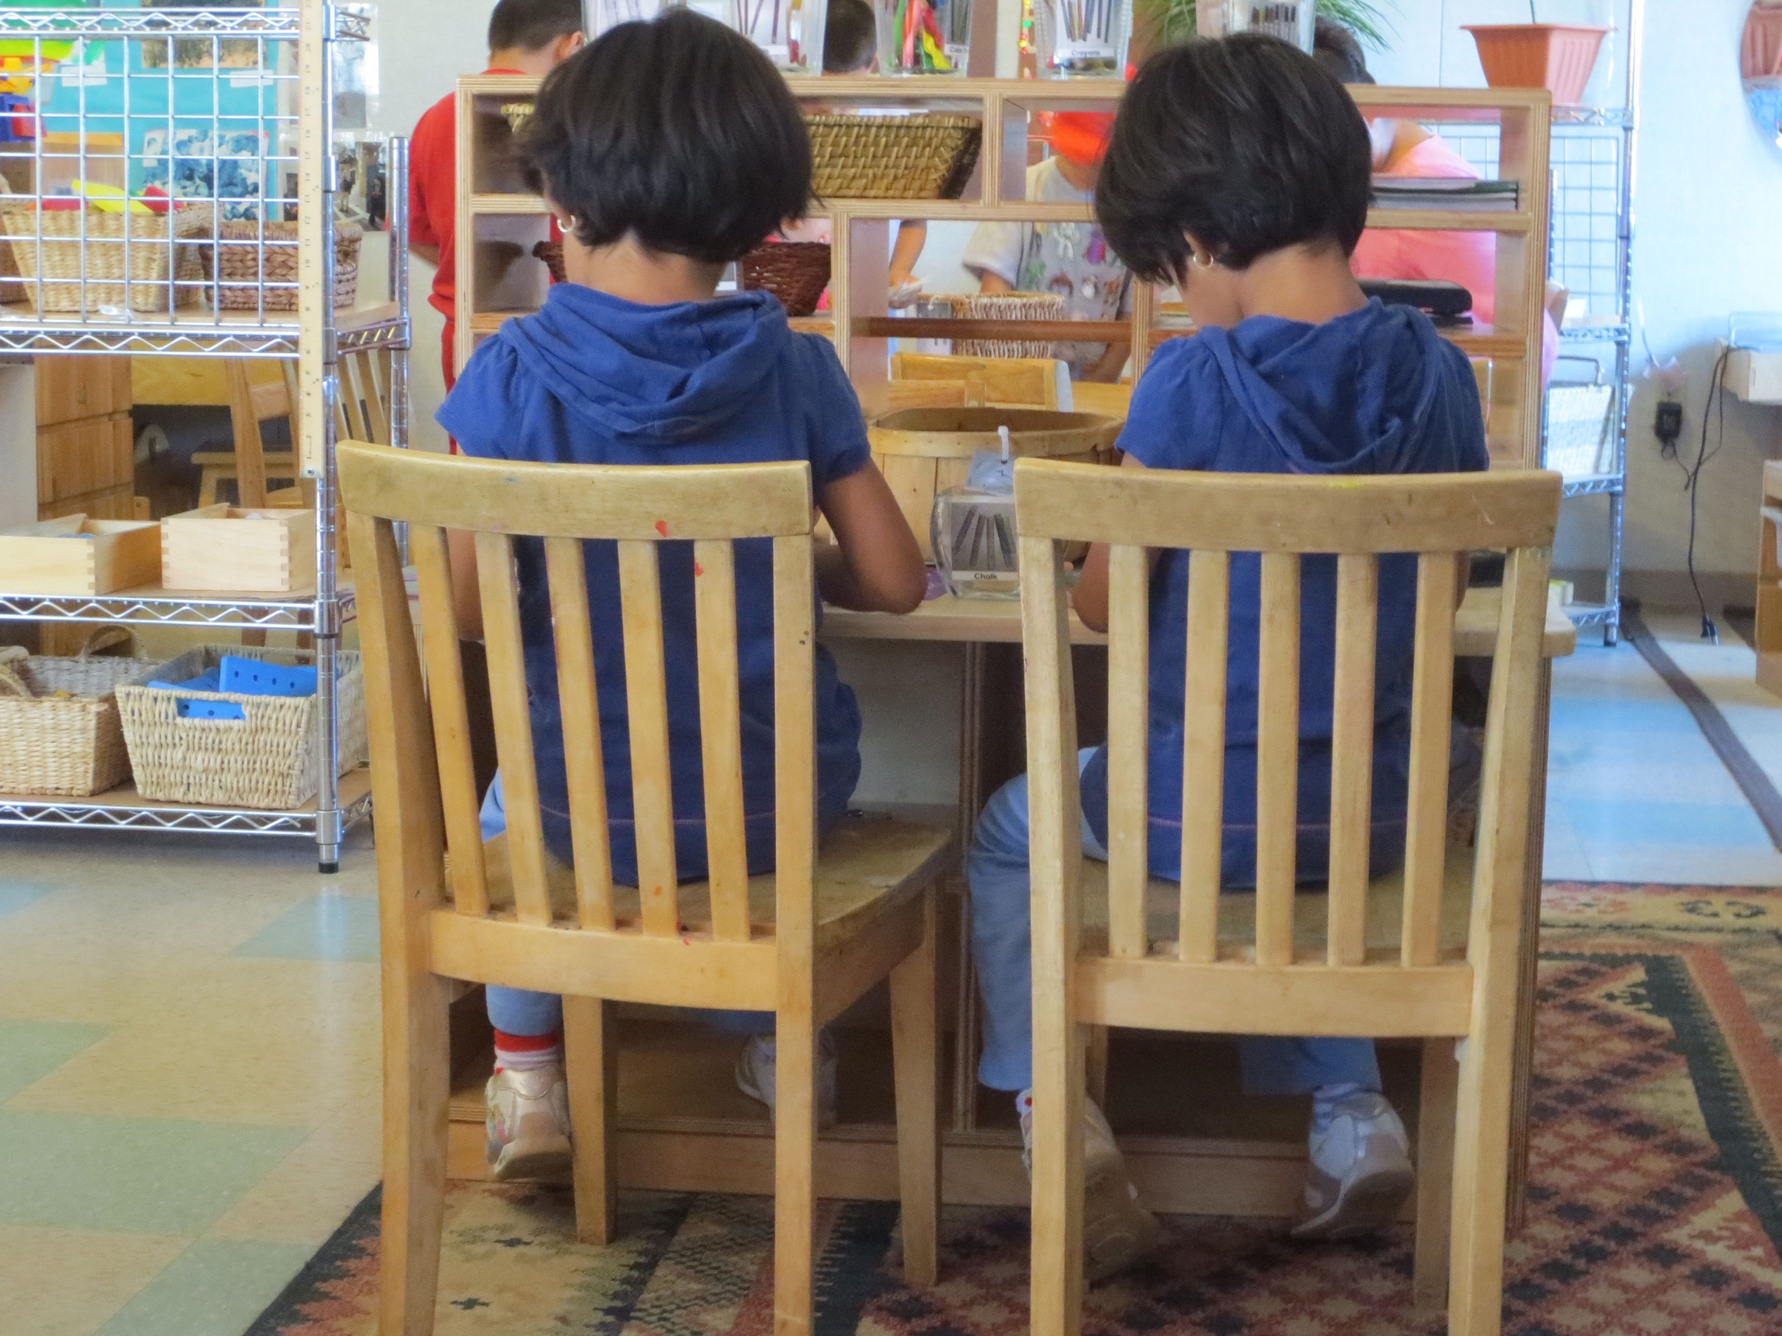
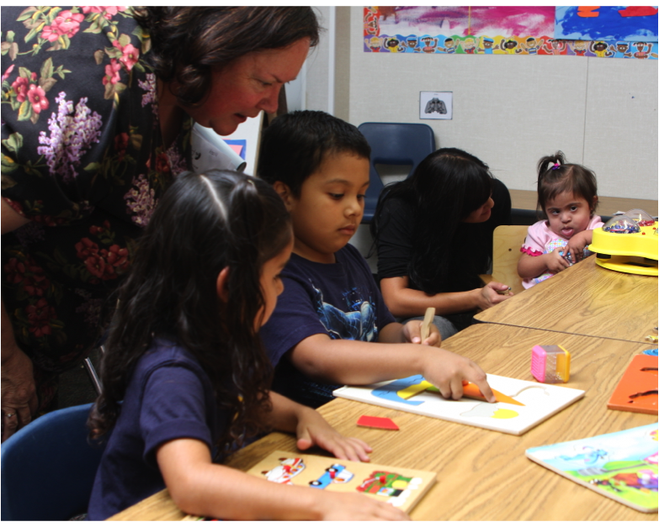
Engaged…
Notes:
What do you notice about these pictures?
Staff sitting, engaged and interested, smiling, children engaged are left alone and observed.

Slide 11
Activities
The following classroom organizational elements are practiced:
  If a transition is observed, there are clear signals beforehand, it is orderly, relatively calm, and it is apparent that the children know what to do
  If a large group/circle is observed, the children are all actively engaged and there is no or little waiting or passive watching of events
  If a small group is observed, it contains four children (if they are mostly 3 years of age) or five children (if they are mostly 4 years of age) or 6 children (if they are mostly 5 years of age)
  If free choice/centers is observed, the conditions named in items 1-3 are present
Notes:
Number 4 is about activities, and you will choose the activities that place during the 20-minute observation.
Quiet calm energy
Children are engaged
Adults are engaged

Slide 12
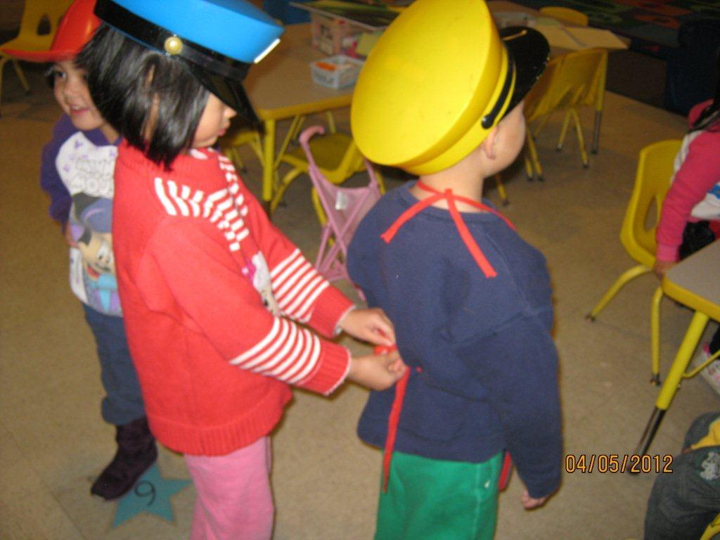
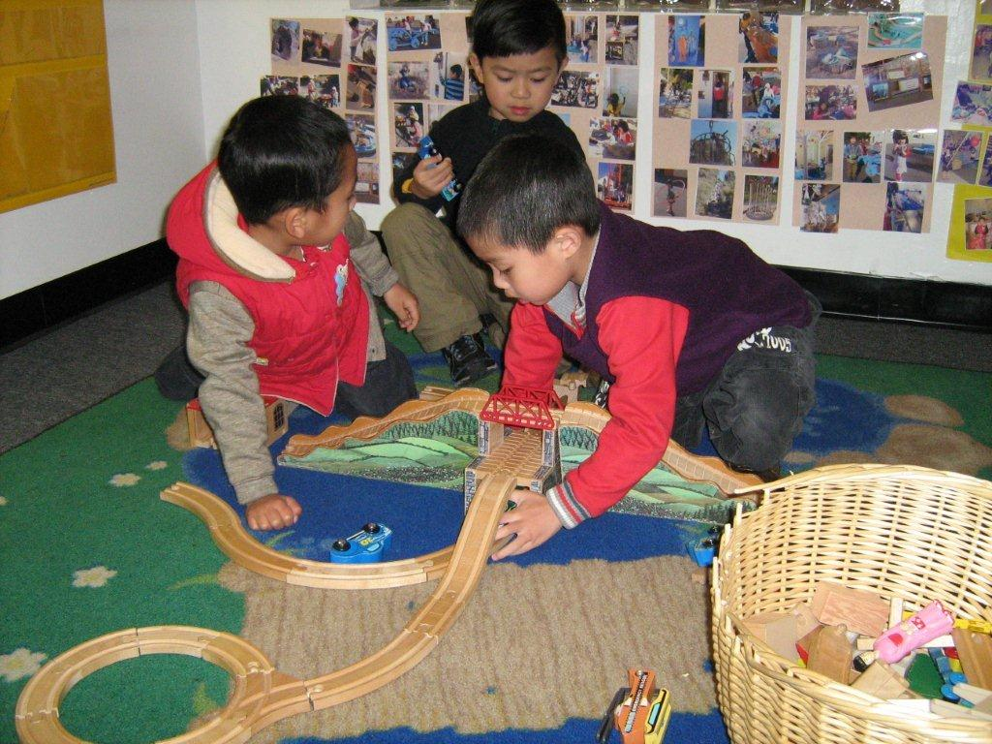
Activities
Notes:
Engagement
Children working together and engaged.

Slide 13
Visual Scan/Postings
The Program-wide Expectations (with photographs) are posted
A Visual Schedule (with photographs) is posted
At least one of the following materials are observable as present in the classroom:
  Emotions chart or photographs of emotions
  Solution Kit
  Emotion Regulation Poster (Tucker, Thermometer, etc.)
  Problem Solving or Conflict Resolution steps
  A scripted story (Super Friend, Sonya Snail, etc.)
  A book on friendships, emotions, etc.
  An art project on self, feelings, etc.
Notes:
Let's review 5,6, and 7
5. Part of the Building the foundation checklist
6. Visual schedule with markers and always present. We will also be checking when monitoring
Each classroom should already have all these items for the TP kit or makde by mentors

Slide 14
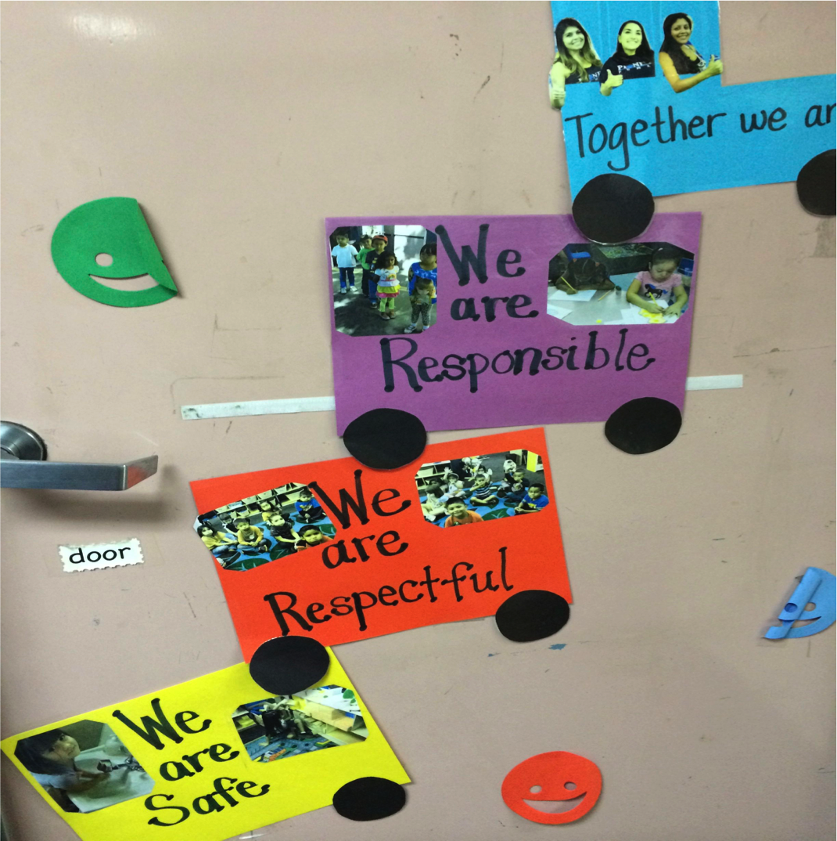
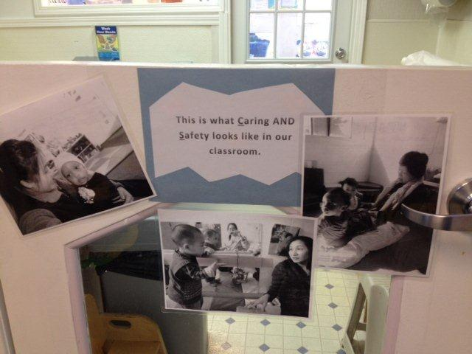
Visuals
Notes:
Use We instead of be – Community vs. Directive

Slide 15
Conversation/Talking
An adult or a child references, mentions, or uses any of the materials listed in items 5, 6, or 7
At least one PDA (Positive Descriptive Acknowledgement) is heard
At least one emotion/feeling word is named, labeled, mentioned, or discussed
Notes:
Here is 8, 9, and 10
5. Program Expectations and rules
6. Visual Schedule
7. TP materials

Slide 16

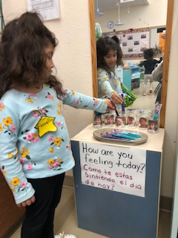
Feelings/PDA
Notes:
Feelings activity

Slide 17
Conversation/Talking
There is at least one instance of direct teaching of a social skill: (Circle the Skill/s taught)
  Friendship—prompts for sharing, helping, taking turns, listening, entering play; reading a book about friendships; Super Friend prompt cards are used
  Emotional literacy—check-in, children move face on chart, children spontaneously name a feeling, are reading a book about feelings
  Managing Strong Feelings—a specific technique is used to help children manage feelings (name on chart, use Tucker/Sonya, Strong Emotion kit or strategies are used, Emotion Thermometer)
  Problem solving—problem solving/conflict resolution sequence, use of Solution Kit
PDA is heard for any of the social skills named in this item (i.e., for being a problem solver, a super friend, recognizing an emotion, calming down)
Notes:
Read through
Second Step, flower and pinwheel

Slide 18
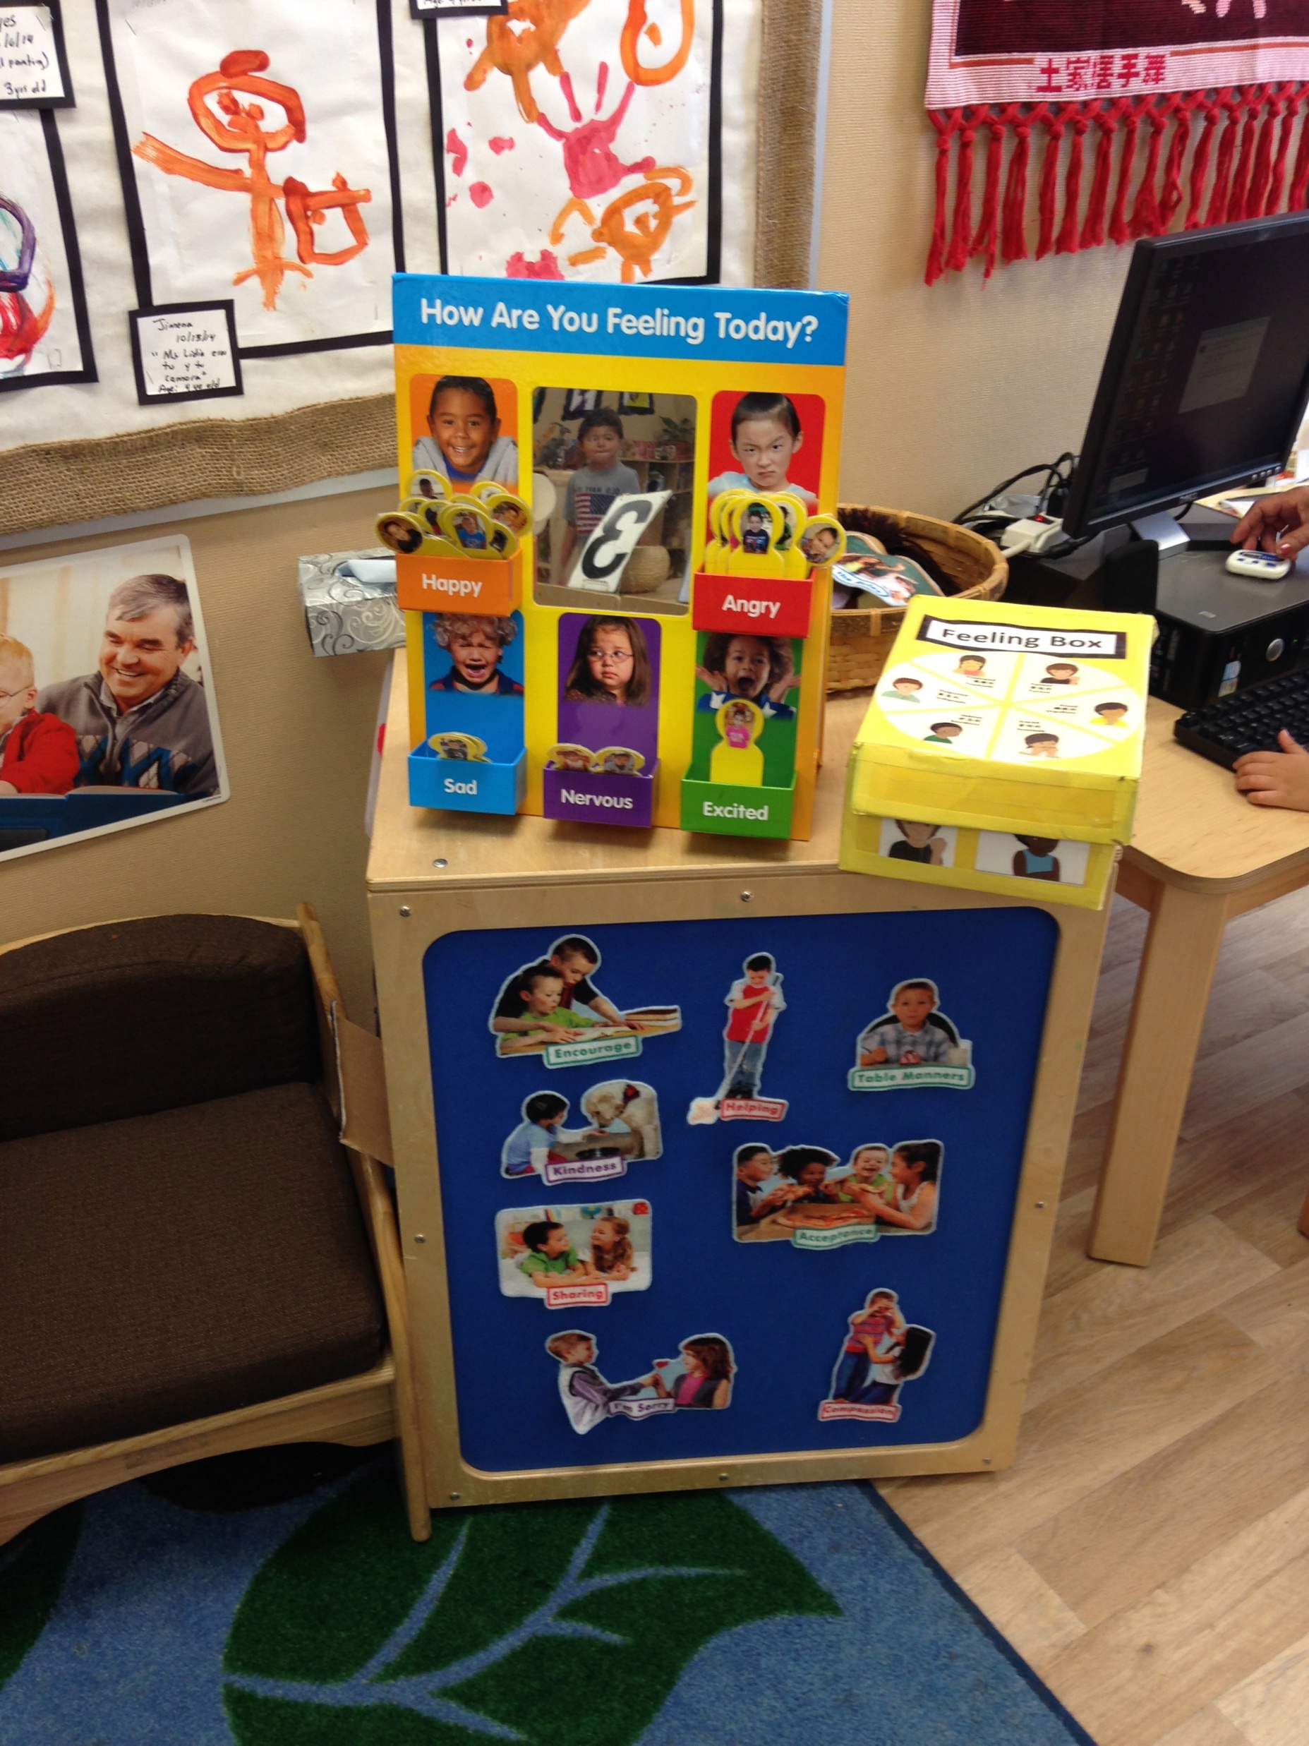
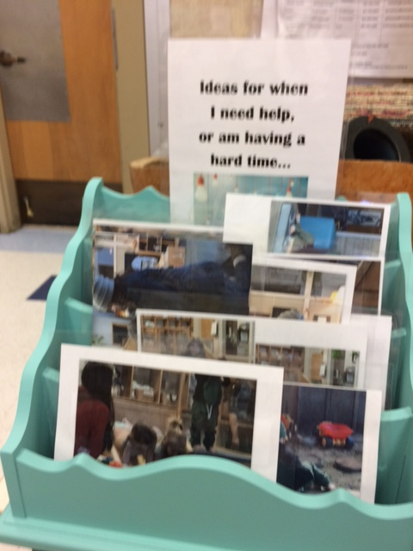
Conversation Starters
Notes:
Feelings poster, box
Ideas for when I need help big pictures

Slide 19
Challenging Behavior
Either of the following take place:
  No challenging behavior is observed OR
  A challenging behavior is observed and the child is prompted to a more appropriate replacement skill or any of the strategies in item 11 are used
Notes:
Review.

Slide 20


Handled!

